Slide 1
A Project presentation On
Implementation of a Smart Hydroponic Greenhouse System using IoT
By
HARSHA S

Slide 2
Abstract
Implementation of a Smart Hydroponic Greenhouse System using IOT
Hydroponic greenhouse systems use water instead of soil for plant cultivation, requiring only vital minerals, nutrients, and proper pH levels.
Hydroponic farming is a highly productive and fast process, with a short harvest time that can minimize costs.
The ESP8266 board collects data from sensors, controls actuators, and communicates with the cloud server and mobile app using wi-fi.
The system is implemented using open-source software and hardware, making it affordable and accessible for small-scale farmers and hobbyists.

Slide 3
Introduction
Implementation of a Smart Hydroponic Greenhouse System using IOT
The main aim is to introduce an IOT-based hydroponic greenhouse system that uses water instead of soil for plant cultivation.
This method shows that soil is not necessary for plant growth, and plants only require essential nutrients, minerals, and pH levels within a specific range in water.
Traditional soil-based agriculture there are soil-related problems such as soil-borne diseases, pests, and weed growth, which can reduce yields and require the use of pesticides and herbicides.
In hydroponic farming, plants are grown in water instead of soil. This means that hydroponic farmers do not have to worry about soil-related problems.

Slide 4
Reason for selecting this project
Implementation of a Smart Hydroponic Greenhouse System using IOT
Hydroponics is a fascinating area of agriculture that has many benefits, including reduced water usage, increased yield, and the ability to grow crops in areas where traditional agriculture may not be feasible.
Additionally, the use of IOT technology in hydroponics is a rapidly growing field that can further improve the efficiency and effectiveness of farming.
The project's use of open-source software and hardware makes it affordable and accessible to small-scale farmers and hobbyists, who may not have access to expensive commercial hydroponic systems.

Slide 5
Literature Survey
Implementation of a Smart Hydroponic Greenhouse System using IOT
YEAR | Author | Title | Description
MAY 2016 | H. Ibayashi, Y. Kaneda, J. Imahara, N. Oishi, M. Kuroda, and H. Mineno | A reliable wireless control system for tomato hydroponics | Wireless control system for hydroponics tomato cultivation.
MAR 2018 | W.-J. Cho, H.-J. Kim, D.-H. Jung, D.-W. Kim, T. I. Ahn, and J.- E. Son | On-site ion monitoring system for precision hydroponic nutrient management | The purpose of the system is to enable farmers to manage the nutrient content of recycled solutions by rapidly detecting imbalances in nutrient ratios.
APR 2018 | C. Cambra, S. Sendra, J Lloret, R. Lacuesta | Smart system for bicarbonate control in irrigation for hydroponic precision farming | The system uses low-cost sensors and micropumps to detect and adjust imbalances in pH levels of nutrient solutions used in hydroponic agriculture.

Slide 6
Implementation of a Smart Hydroponic Greenhouse System using IOT
OCT 2018 | R. Vidhya and K. Valarmathi | Survey on automatic monitoring of hydroponics farms using IoT | The paper aims to identify existing technologies and methods used for automated monitoring of hydroponic farms using IoT.
2019 | U. Ampant K. Kularbphettong N. Kongrodj | An automated hydroponics system based on mobile application | The study highlights the benefits of the automated hydroponic system and identifies two parts: automatic and manual..
JUN 2020 | R. S. N. A. R. Aris, K. I. B. Mohammad, L. Safiyahbintisyafie, F. H. Bintiazimi, and S. B. Aw | Front-end development of nutrient film technique for hydroponic plant with IoT monitoring system | The developed system offers real-time monitoring and control of various parameters such as flow rate, temperature, EC and pH values and can be viewed remotely via smartphone or desktop computer.
OCT 2020 | M. E. H. Chowdhury, A. Khandakar, S. Ahmed, J. Hamdalla, F. Haque, M. B. I. Reaz, A. Al Shafei, and N. Al-Emadi | Design, Construction and Testing of IoT Based Automated Indoor Vertical Hydroponics Farming Test-Bed in Qatar | The low-cost automated vertical hydroponic system is designed to be integrated into a small indoor space.

Slide 7
Problem Statement
Implementation of a Smart Hydroponic Greenhouse System using IOT
By past research, it has been found that the need for manual checks to deliver essential nutrients is extensive, and that the system used for communication within hydroponic farms is inappropriate for remote communication.

Slide 8
Objectives
Implementation of a Smart Hydroponic Greenhouse System using IOT
To address these challenges, the proposed solution involves using a micropump to deliver essential nutrients automatically if the nutrient level is low. This can greatly reduce the need for manual checking and ensure optimal nutrient levels for the plants.
Additionally, Blynk cloud is used for remote communication, which can enable the farmer to monitor and control the system from a remote location. This can greatly improve the efficiency of the system and reduce the workload of the farmer.

Slide 9
Implementation of a Smart Hydroponic Greenhouse System using IOT
Methodology
BLYNK CLOUD
Temperature, TDS and Ultrasonic sensors
NodeMCU ESP8266
OLED Display
Water Pump
Micropump
LED Lights

Slide 10
Implementation
NO
TURNOFFWATERPUMP= =1
START
NO
LDR < 100
YES
LDR < 100
BLYNK RUN
Read and display Temperature
Read and display TDS, EC and PPM
Read and display Water level
Update widget on BLYNK APP
TURN OFF LED
TURN OFF LED
YES
TURN ON LED
TURN ON LED
TURN ON THE WATER PUMP
15 MINUTES DELAY
15 MINUTES DELAY
20 MINUTES DELAY
NO
PPM < Nutrients value
BLYNK RUN
BLYNK RUN
TURN OFF THE WATER PUMP
YES
ADD Nutrients
STOP

Slide 11
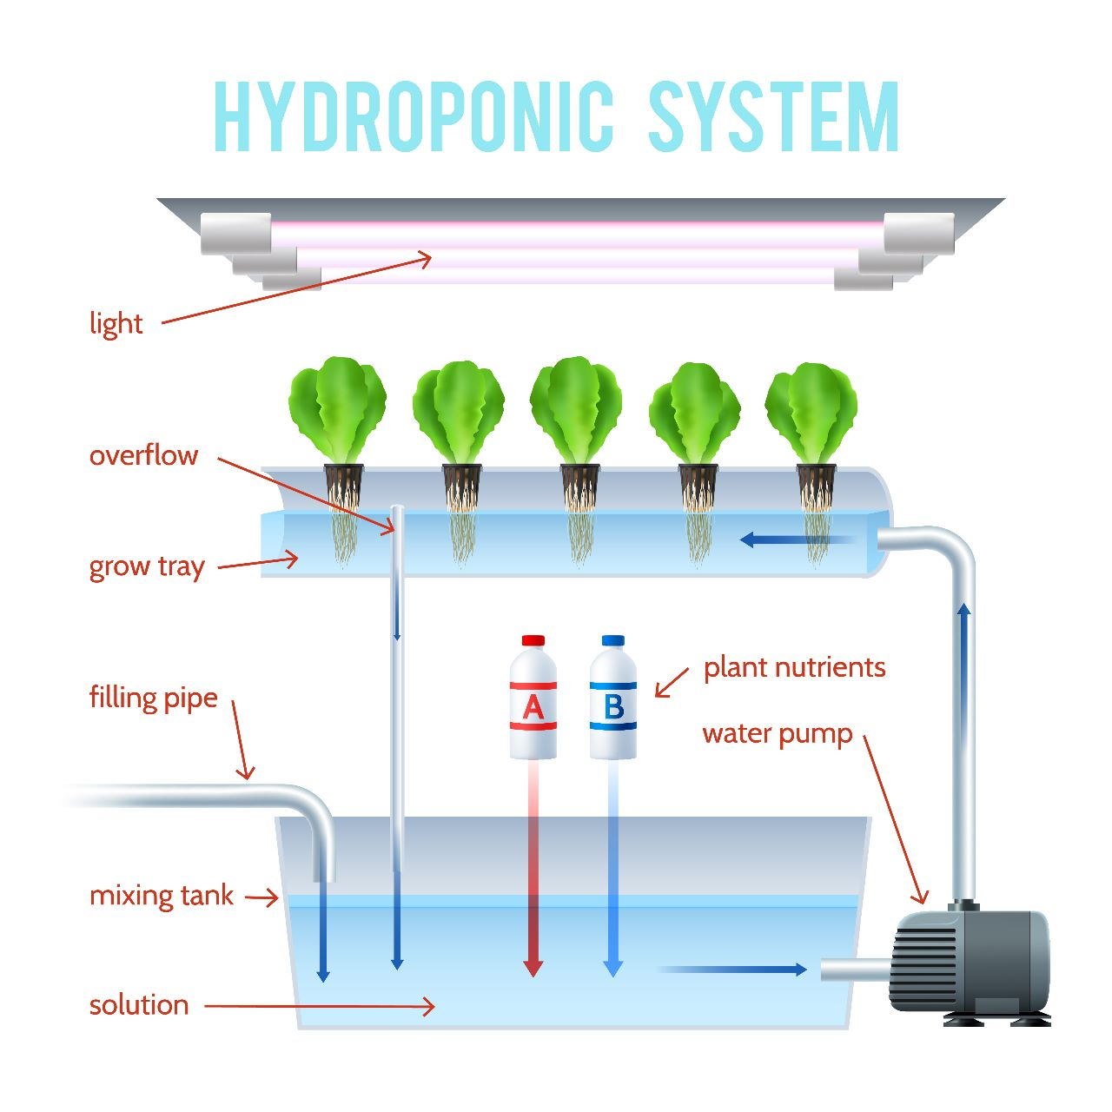
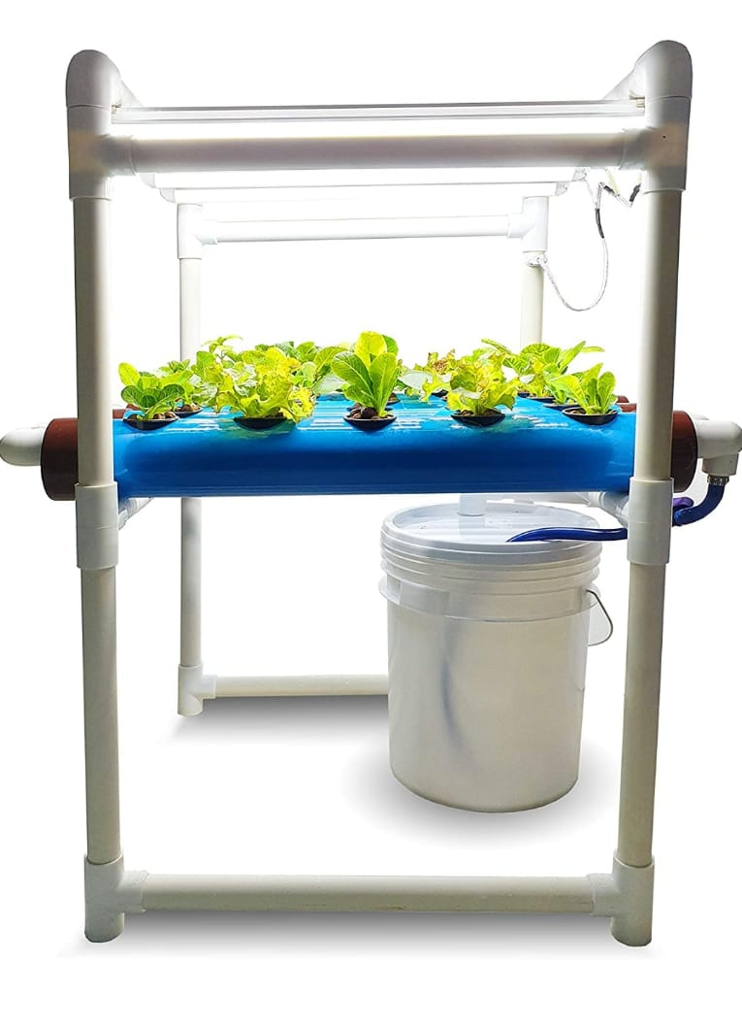
Hydroponics System Working
Implementation of a Smart Hydroponic Greenhouse System using IOT

Slide 12
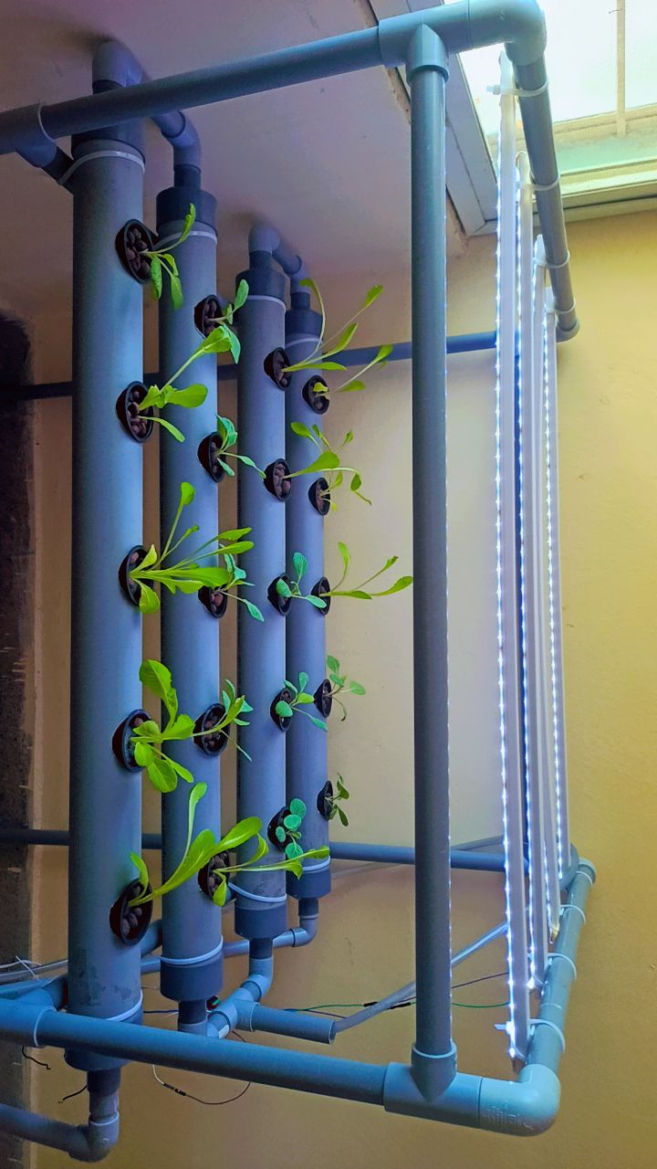
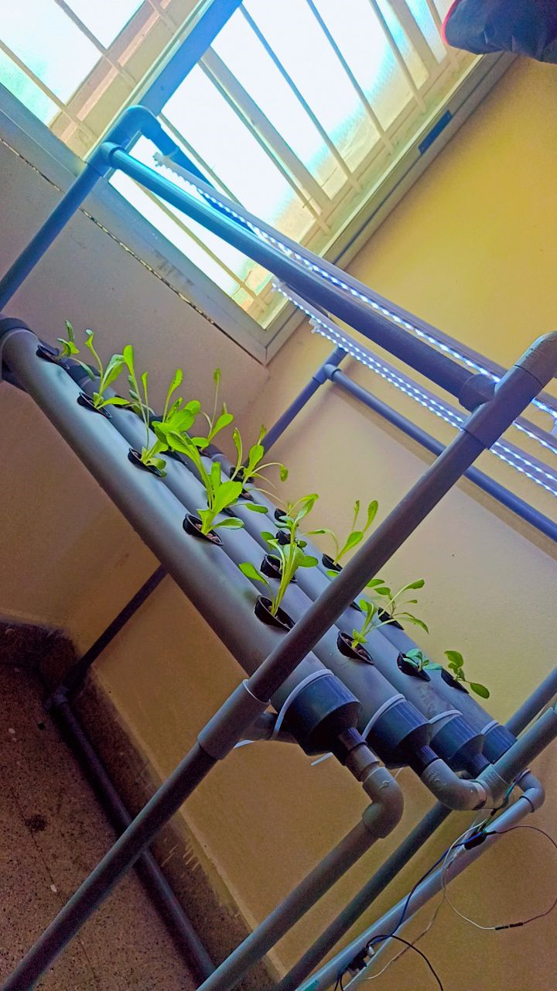
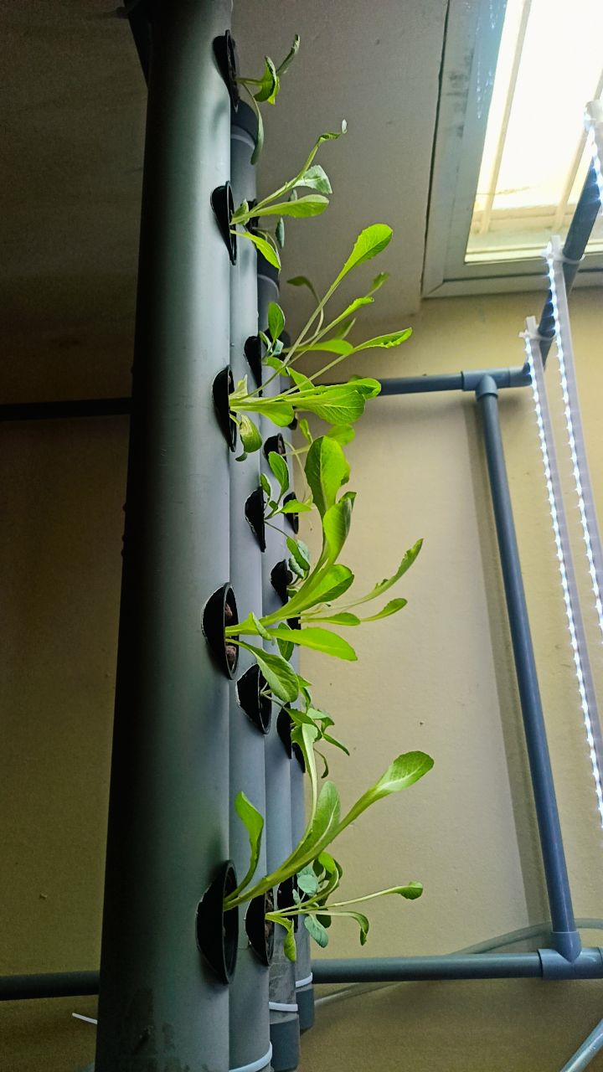

Slide 13
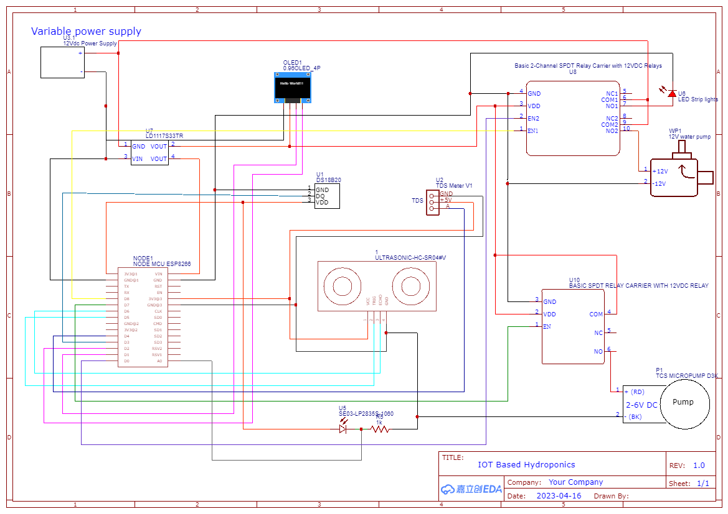
Implementation of a Smart Hydroponic Greenhouse System using IOT
CIRCUIT DIAGRAM

Slide 14
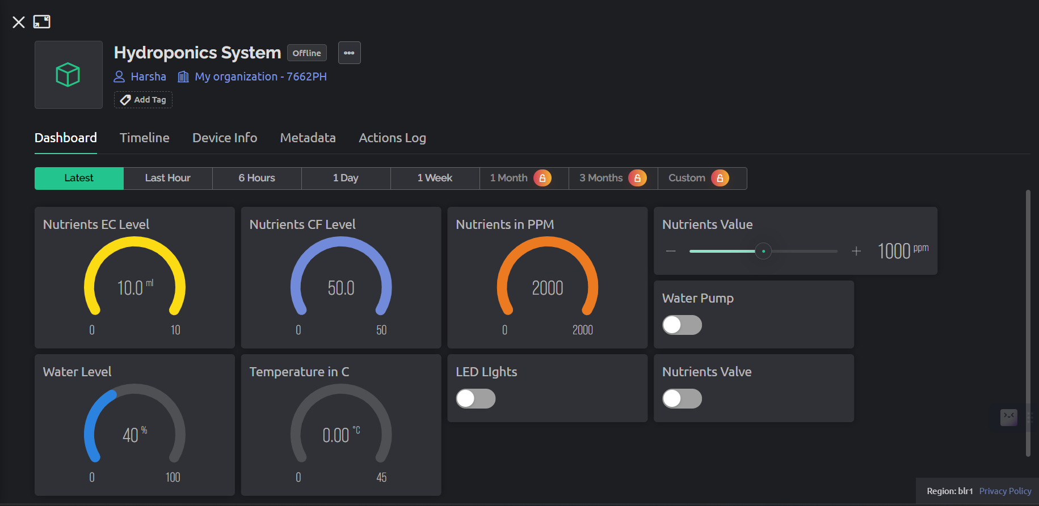
WEB Dashboard
Implementation of a Smart Hydroponic Greenhouse System using IOT

Slide 15
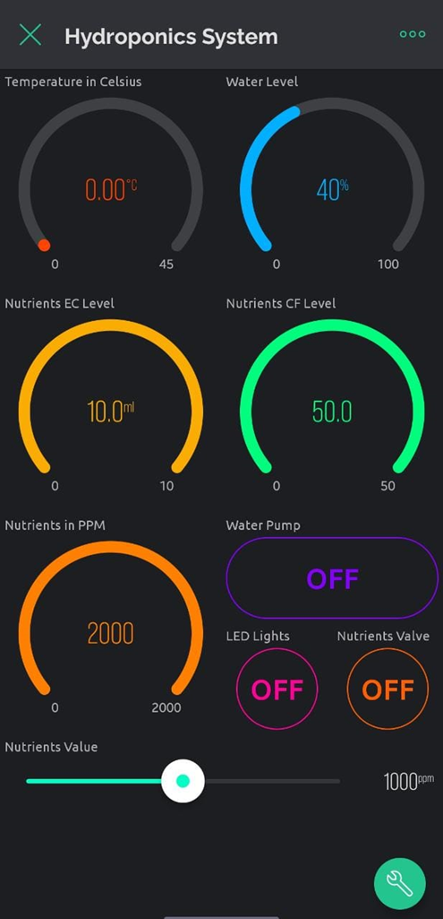
Mobile Dashboard
Implementation of a Smart Hydroponic Greenhouse System using IOT

Slide 16
Requirements
Implementation of a Smart Hydroponic Greenhouse System using IOT
1) Software requirements:
Windows 11
Arduino IDE
Blynk cloud
2) Hardware requirements:
NodeMCU ESP8266
Electrical conductivity sensor & TDS meter V1.0 development board
DS18B20 temperature sensor
0.96 inch OLED module 128x64 SSD1306 driver
HC-SR04 ultrasonic
5v Micropump
12v 700L/H brushless submersible water motor pump
LED strip lights
LDR sensor

Slide 17
Conclusion
Implementation of a Smart Hydroponic Greenhouse System using IOT
The proposed solution addresses the challenges related to manual checks for delivering essential nutrients in hydroponic farms and the inappropriate system for remote communication. By implementing a 5v micropump, the system can automatically deliver essential nutrients when the nutrient level is low, reducing the need for manual checking and ensuring optimal nutrient levels for the plants. Additionally, the integration of the BLYNK cloud platform allows farmers to remotely monitor and control the system, significantly improving efficiency and reducing their workload.
Overall, the proposed solution and the accompanying program offer a practical and effective approach to address the challenges associated with nutrient delivery and remote communication in hydroponic farming. It provides a foundation for future advancements and optimizations in hydroponic systems, contributing to the development of sustainable and high-yielding agriculture practices.

Slide 18
References
Implementation of a Smart Hydroponic Greenhouse System using IOT
M. G. Pitman and A. Läuchli, “chapter 1 global impact of salinity and agricultural ecosystems agricultural losses caused by salinity are difficult to assess but estimated to be substantial and expected to increase with time . secondary salinization of agricultural lands is particular,” pp. 3–20, 2002.
J. C. Zhao, J. F. Zhang, Y. Feng, and J. X. Guo, “the study and application of the IOT technology in agriculture,” in proceedings - 2010 3rd IEEE international conference on computer science and information technology, ICCSIT 2010, 2010.
M. Shahbaz and M. Ashraf, “improving salinity tolerance in cereals,” critical reviews in plant sciences. 2013.
Resh, h.M. Hydroponic food production: A definitive guidebook for the advanced home gardener and the commercial hydroponic grower; 19 April 2016.
V. Palande, A. Zaheer, and K. George, “fully automated hydroponic system for indoor plant growth,” Procedia compute. Sci., Vol. 129, pp. 482–488, 2018.
Pooja Mittal , Navita. A survey on internet of things (IoT) based healthcare monitoring system. International journal of advanced trends in computer science and engineering. Volume 8, no.4, July – August 2019.

Slide 19
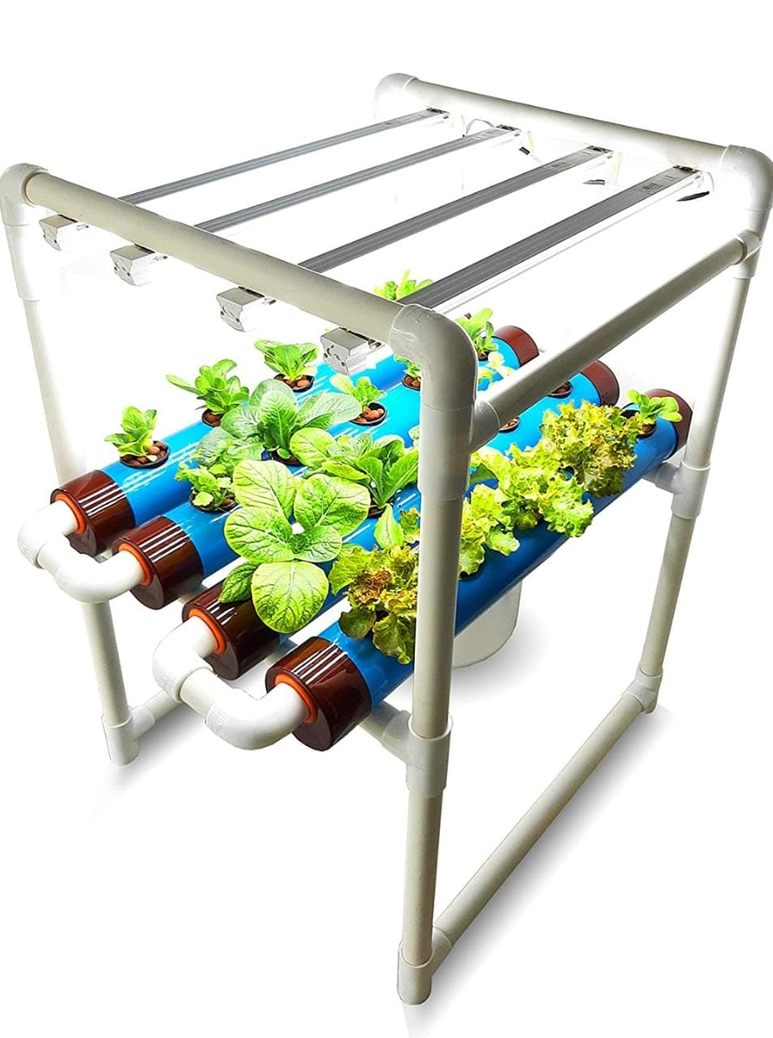
THANK YOU

